Slide 1


Remote Thermal Viewing within High Voltage PCB Subsystem - Julia Garcia

Slide 2
Thermal Sensor/PCB (Julia)
Buck Converters
Power to ESP32-WROOM-1
Expected Output: 3.3 V
Measured Output: 3.31 V
Power to VDDIO Pin of Camera
Supply used for System IO
Expected Output: 3.1 V
Measured Output: 0.099 V
Power to VDDC Pin of Camera
Supply for MIPI Core, Phase Lock Loop, ASIC Core
Expected Output: 1.2 V
Measured Output: 1.22 V
Power to VDD Pin of Camera
Supply for Sensor
Expected Output: 2.8 V
Measured Output (11/17/24): 2.69 V
Measured Output (11/21/24): 0.02 V
Sensor Output
I haven’t tested the sensor’s output data that is sent to the microcontroller because the supply to the input/output of the sensor hasn’t worked at all during testing.
I haven’t put the camera into the board because I didn’t want anything to happen the sensor itself.

Slide 3
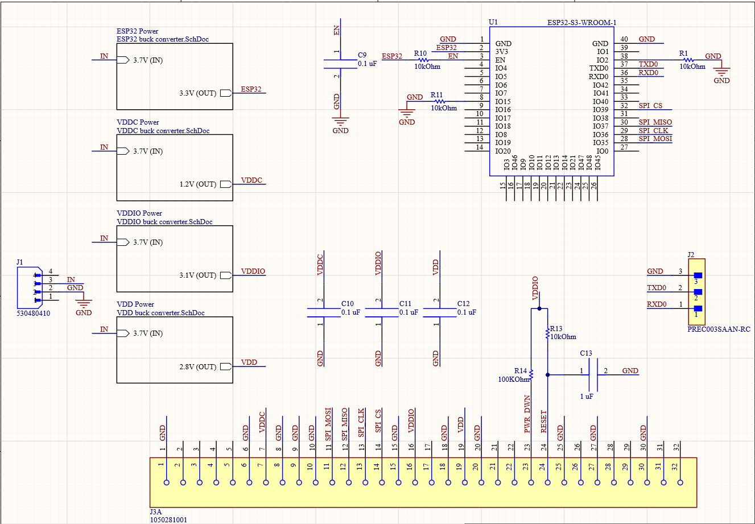
Thermal Sensor/PCB (Julia)

Slide 4
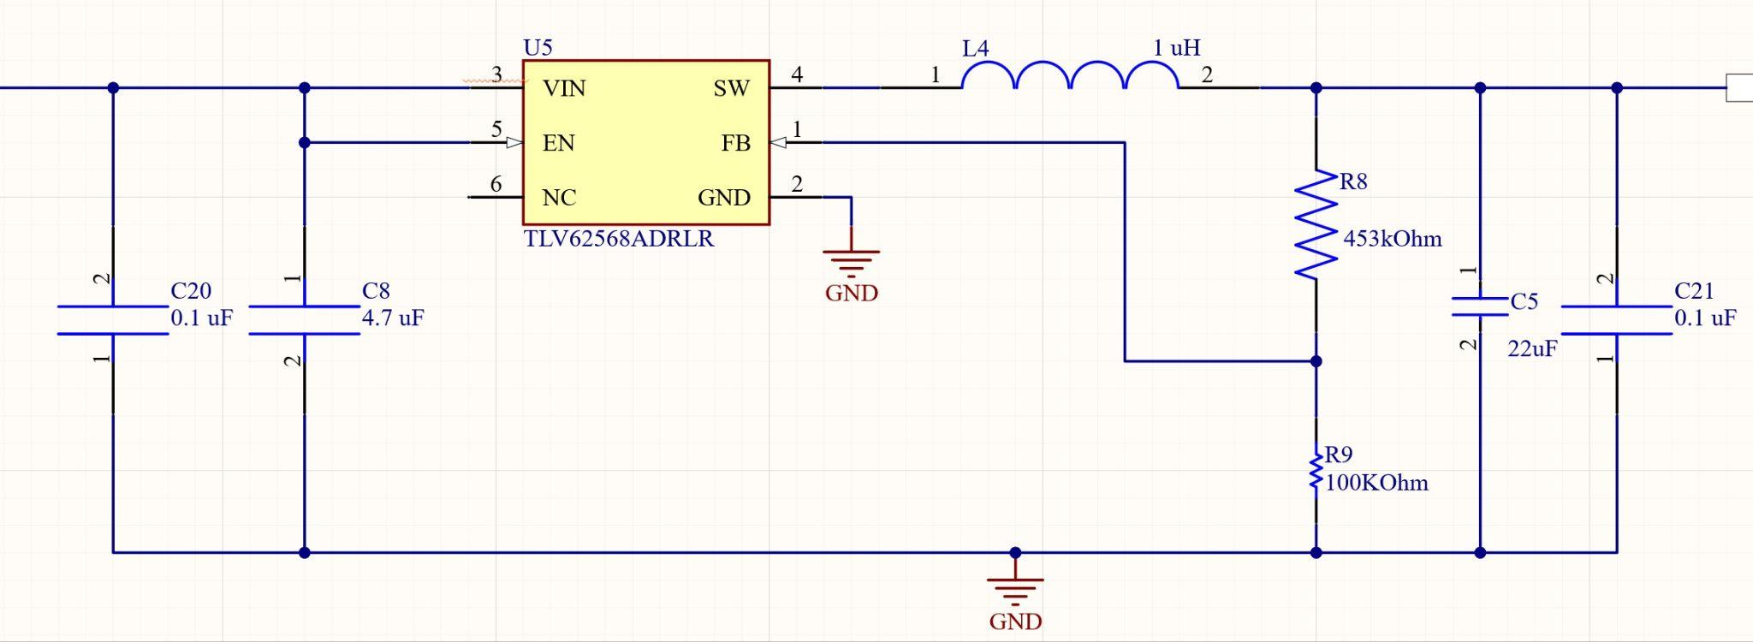
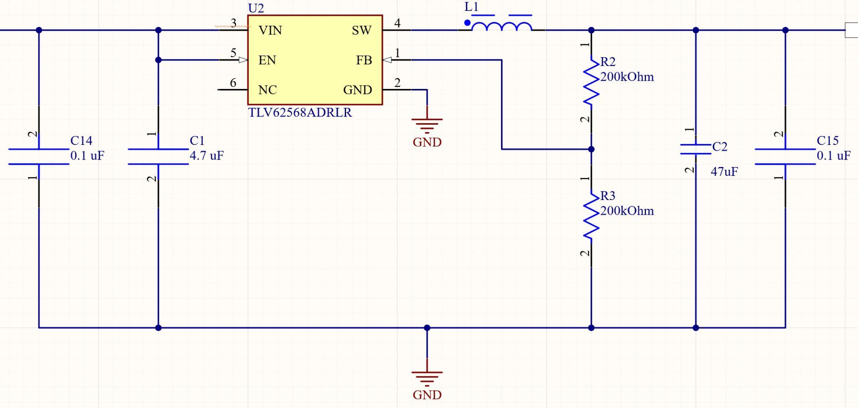
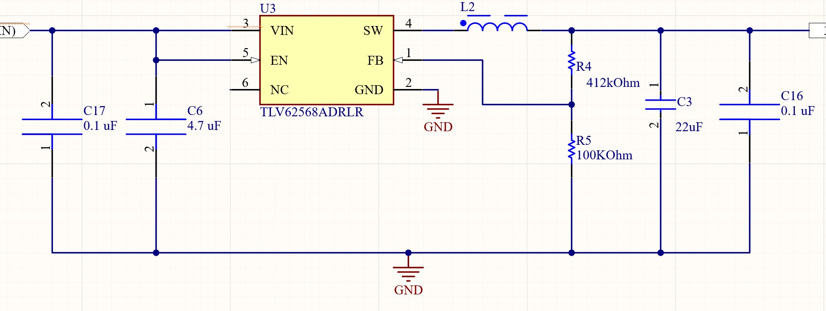
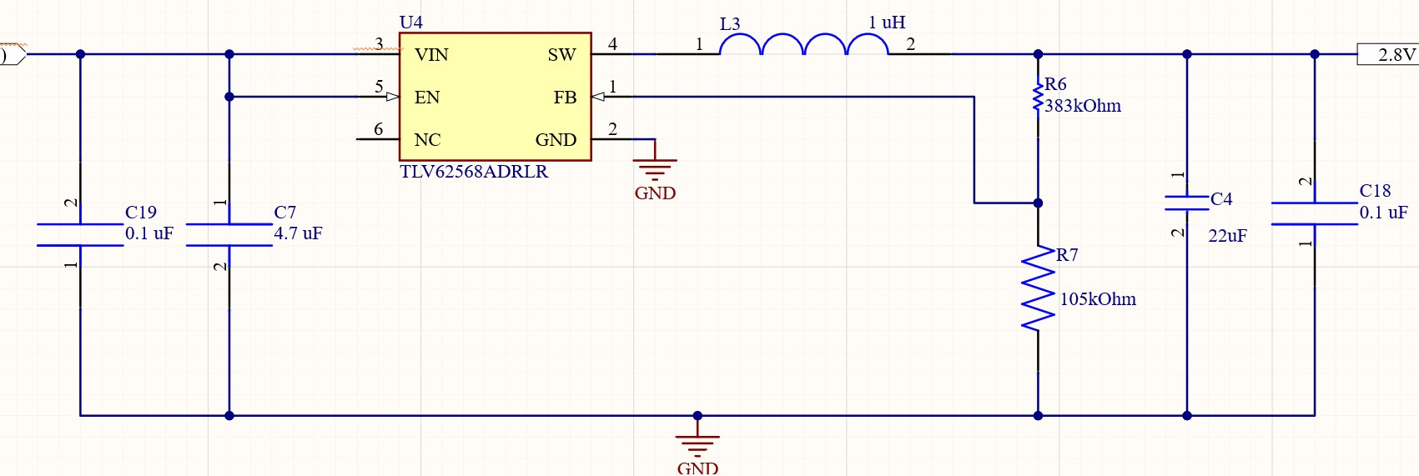
Thermal Sensor/PCB (Julia)
ESP32
VDDC
VDDIO
VDD

Slide 5
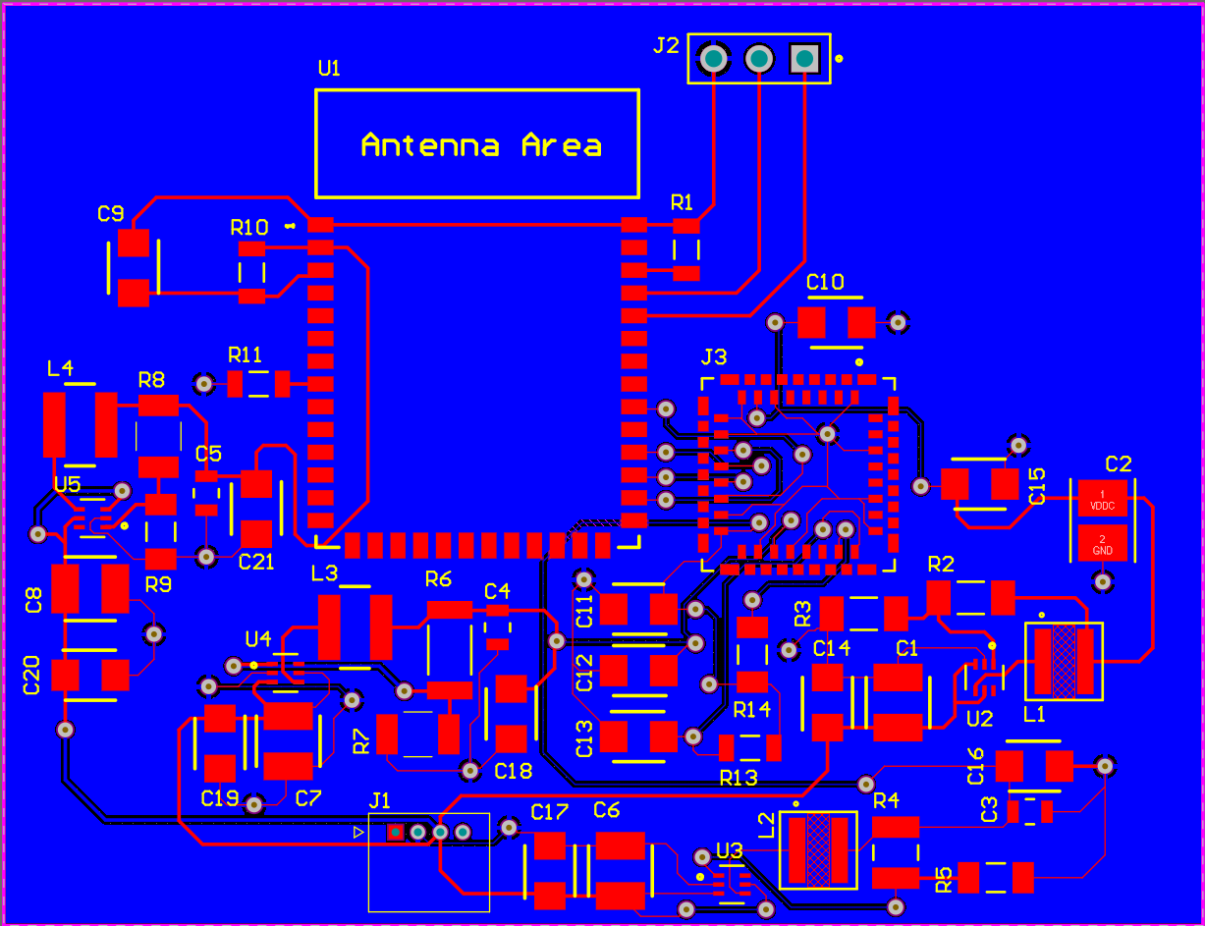
Thermal Sensor/PCB (Julia)

Slide 6
Thermal Sensor/PCB (Julia)
Completed -
Entire PCB design
4 individual buck converter designs
Simulated all designs on WEBench
Designed schematic
created necessary footprints
Routed the board
Soldered the board
Problems
2 buck converter don’t output correct values
1 converter is ~0.2 V off
1 converter ~3 V off
Battery died during testing
404 Plans
Improve board if needed
Help with camera integration

Slide 7
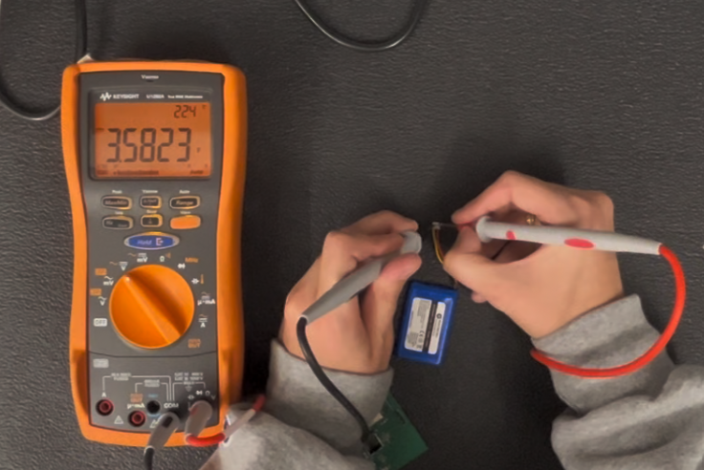
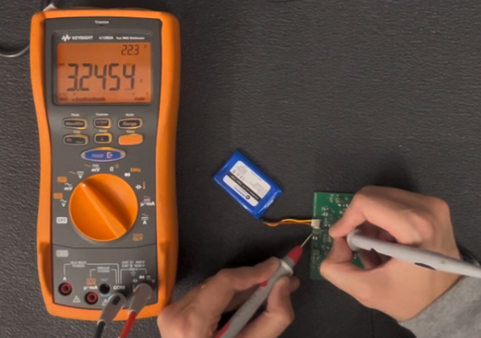
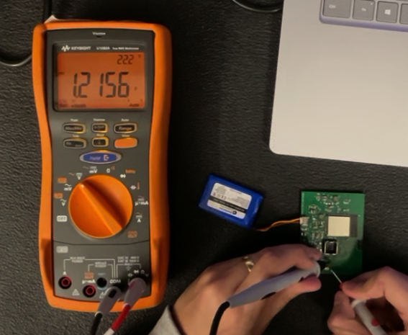
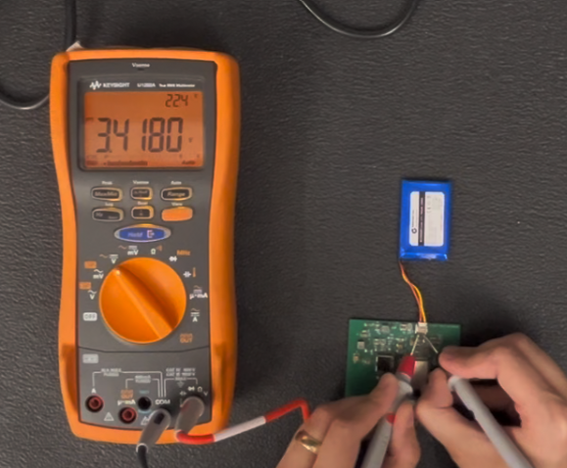
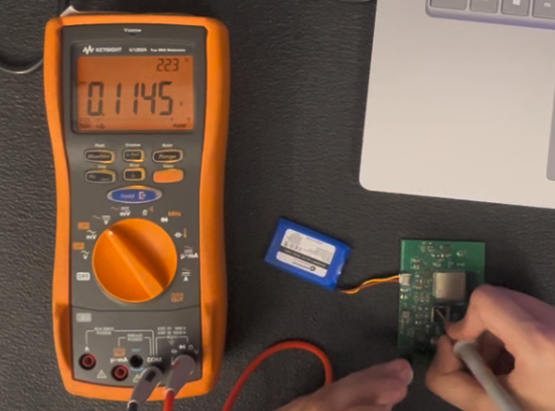
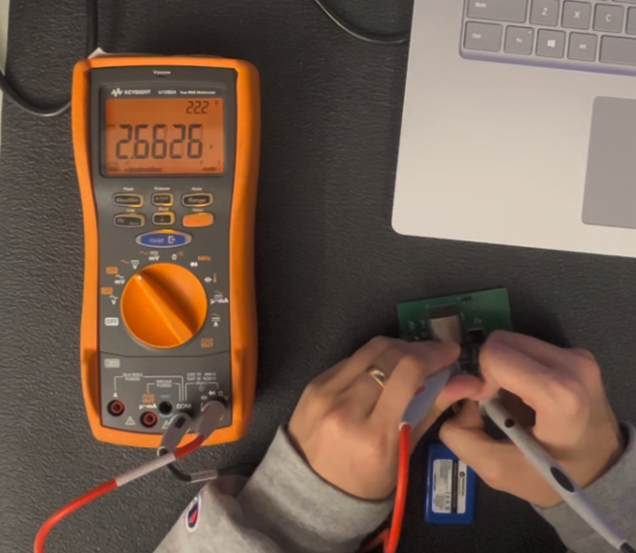
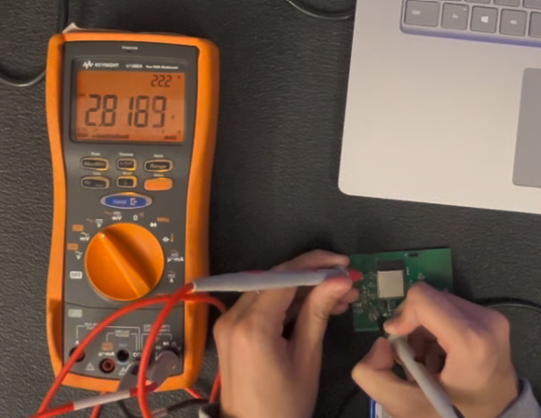
Thermal Sensor/PCB (Julia)
Battery Unplugged
nominal voltage ~3.7 V
Input Tested on Components
nominal voltage ~3.7 V
Output #2 Voltage to VDDC
Expected output ~1.2 V
Battery Plugged In
nominal voltage ~3.7 V
Output #1 Voltage to VDDIO
Expected output ~3.1 V
Output #3 Voltage to VDD
Expected output ~2.8 V
Output #4 Voltage to VDD
Expected output ~3.3 V

Slide 8
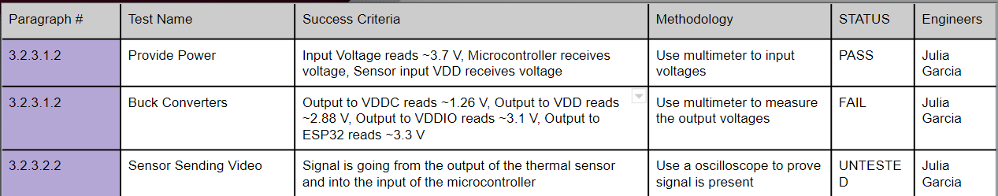
Validation Plan

